Slide 1

The AliveUI
Your Mental Health Assistant

Slide 2
Agenda
Problem statement : Why mental health?
Flow
Features
Demo
Unique features
Roadmap Ahead

Slide 3

Problem Statement
There is a dire need of the
human touch,
candid conversation
stress management and
thoughtful solutions
to address the current COVID
situation.

Slide 4
Seven stages of mental health
Pre-conception
Contemplation
Seeking Help
Engagement
Recovery
Maintenance
Crisis

Slide 5


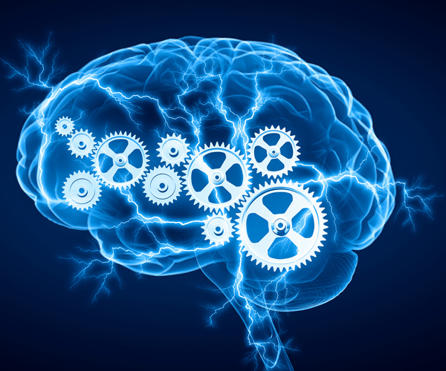

Our Solution
Chatbot
Personalized solution.
Mental Health Tests
Community Interaction

Slide 6
Flow

Slide 7


Slide 8
Flow Diagram
Front End
Back End
Database layer
Sign In
Fetch Details
of User
User Database
Mental Health Test
Find Relevant Questions on the basis of user and answer chosen
End User
User
Question Database
Question with Options
Give Response
Submit Test
Calculate Score according to response
User wants to check his/her stress or anxiety level and need some useful stuff to decrease stress
Estimated Score and Summary of his Problem with Relevant Therapy
Recommend Therapies on the basis of score and user interest
Recommendation Database

Slide 9

Features

Slide 10

Alive UI features for 7 stages
Pre-conception
Contemplation
Seeking Help
Engagement
Recovery
Maintenance
Crisis
}Stress Test
}Oliver Chatbot
}Community Page
}
Continuous evaluation and recommendation
based therapy

Slide 11
Demo

Slide 12
Unique Features

Slide 13


Slide 14
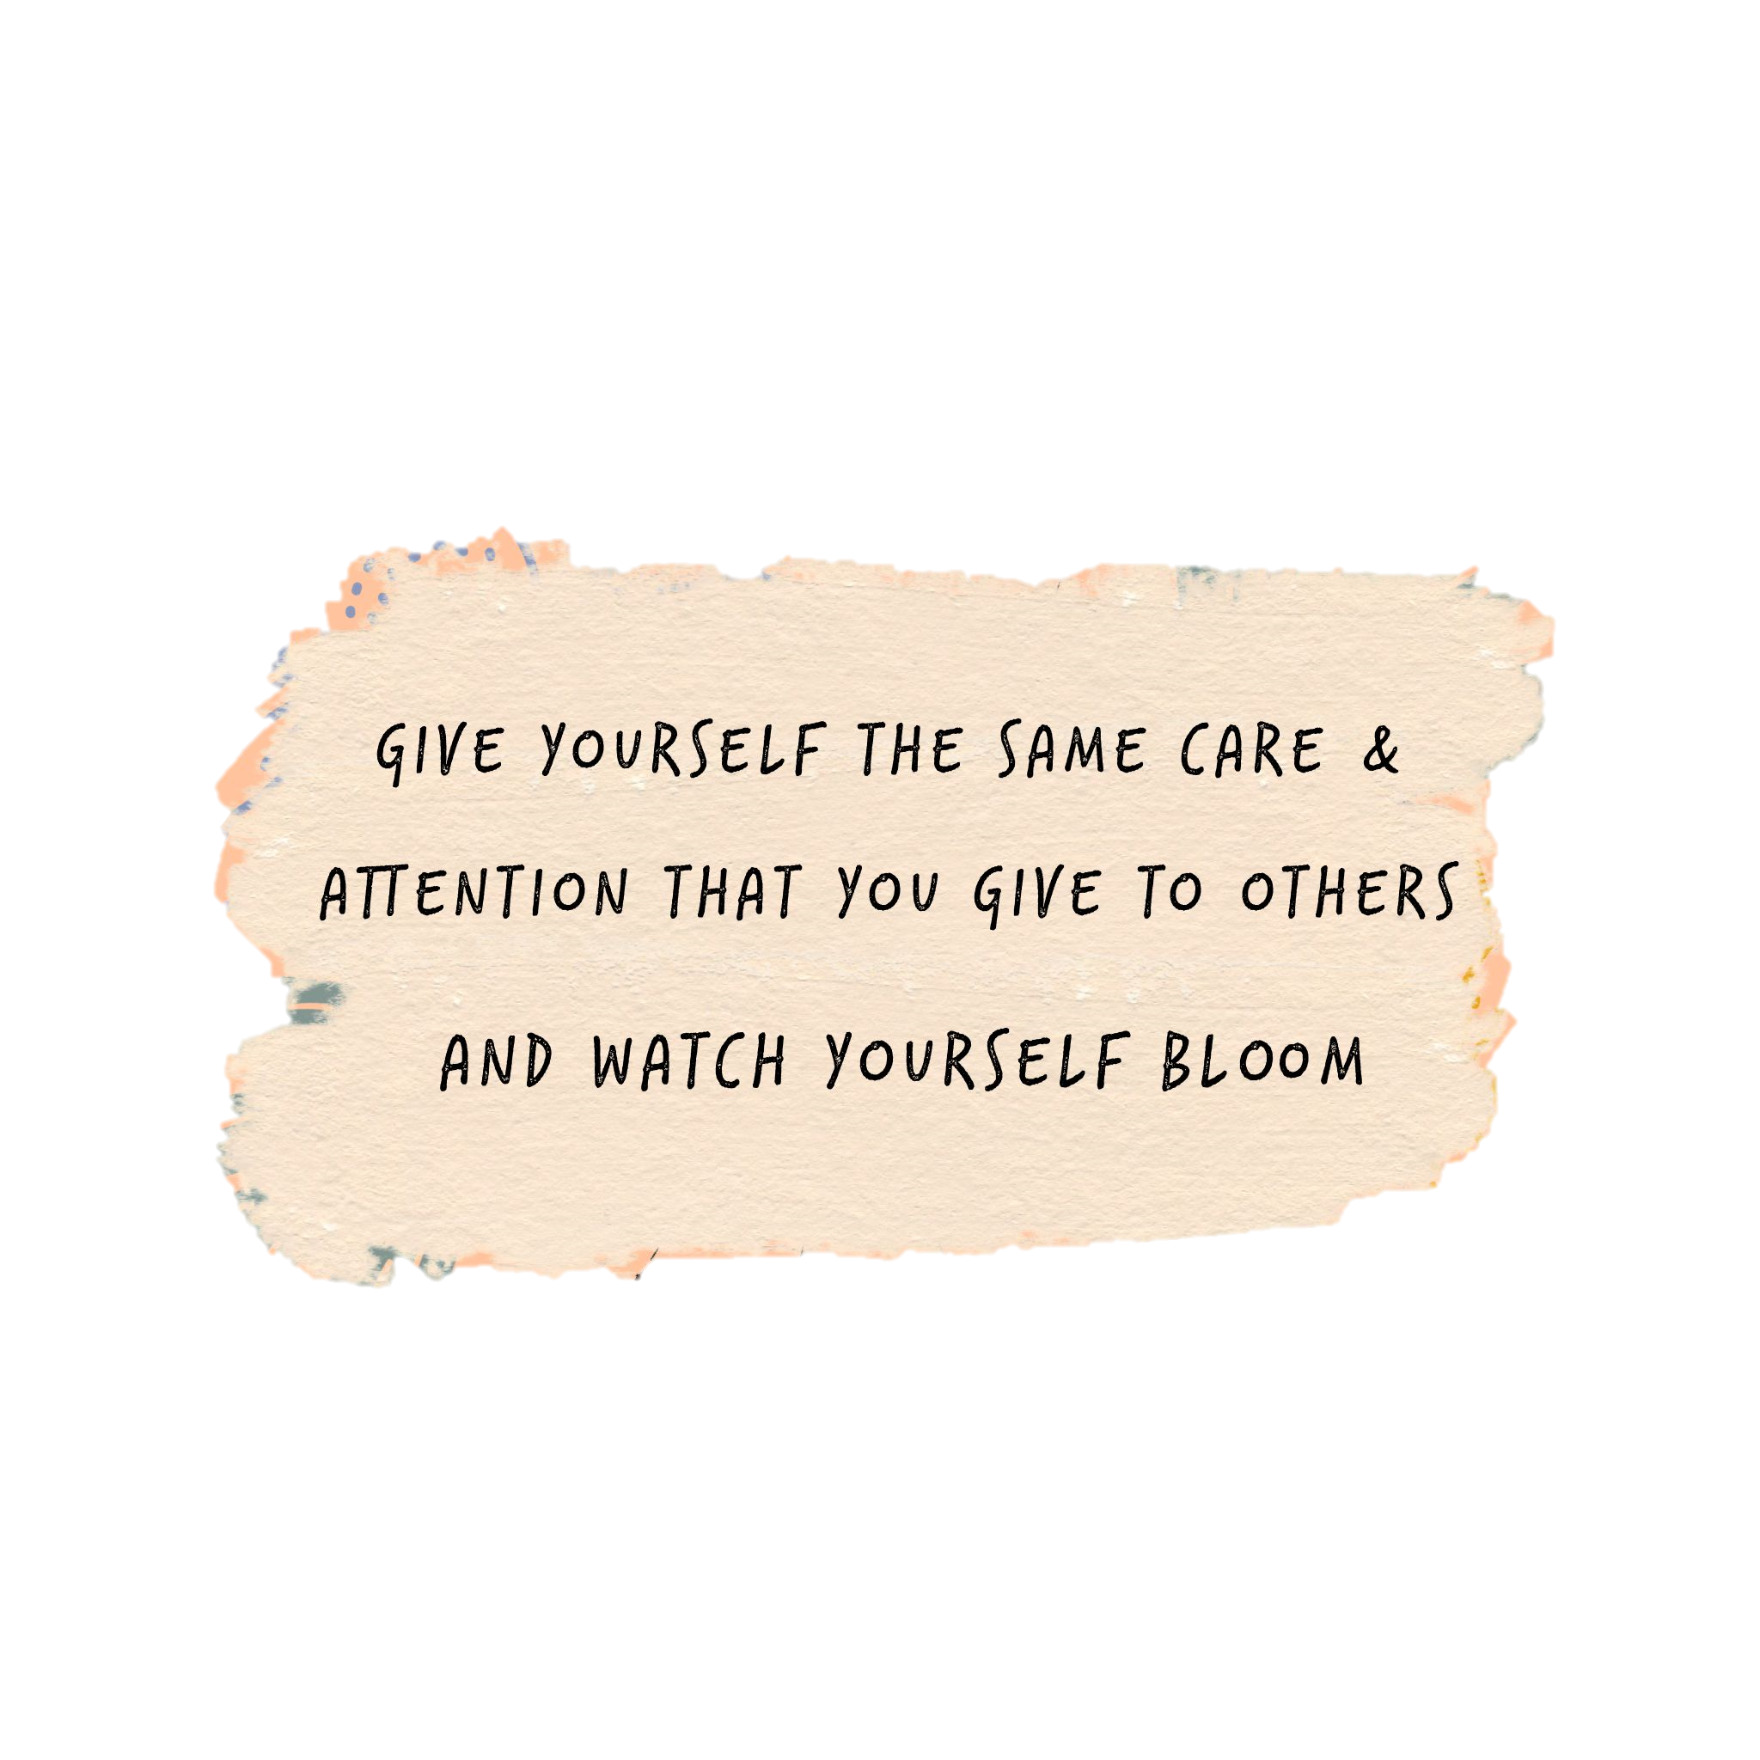

Thankyou.

